Slide 1
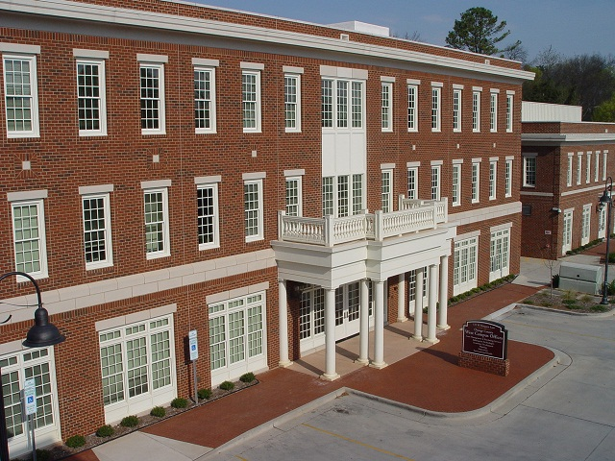
Sustainability & Environmental Responsibility in Orange County
June 16, 2015

Slide 2
Purpose and Background:
To receive updates from multiple County departments on sustainability initiatives, including:
    Environmental Responsibility in County Government (ERG) goal
    FY 14 Utility and Fuel Scorecard
2005
2010
2006
2011
2012
2014
2007
2008
2009
2013
ERG Adopted, Energy Water and Fuel Policies
ESAC Formed
ERG Status report
Utility & Fuel Conservation report
ERG Progress report
ERG Progress report

Slide 3

Sustainability Activities Across the County
Dept. of the Environment, Ag., Parks & Recreation
  David Stancil
Information Technologies
  Jim Northrup
Planning, Inspections, Orange Public Transit
  Craig Benedict
Solid Waste
  Blair Pollock
Asset Management Services
  Brennan Bouma

Slide 4
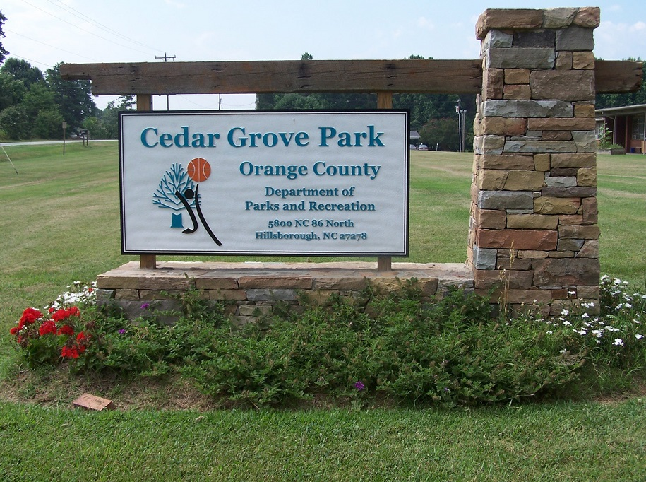
Department of Environment, Agriculture, Parks & Recreation (DEAPR)
Conserving and managing the natural and cultural resources of Orange County

Slide 5

State of Environment Report 2014
SOE Reports prepared every 4-5 years
Uses trends, indicators and benchmarks to assess 23 environmental indicators
Indicators assessed status and
trend
14 of 19 indicators show good
or fair status
Critical and emerging issues
addressed

Slide 6

Orange County Environmental Summit
Held October 2014 - Maple View Education Center
Presentation of SOE 2014 Report
Guest Speakers on
  Invasive Species (Johnny Randall)
  Future of Jordan Lake (Don Francisco), and
  “Lessons from the Land”
  (Dr. Norm Christenson, keynote)

Slide 7
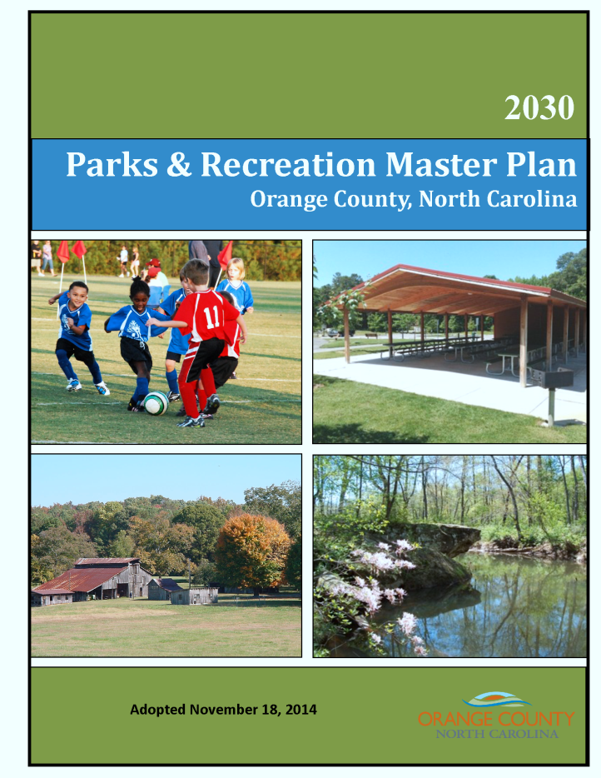
Environment and Nature Education
Continue to offer series of environmental education and nature programs
High interest expressed in P&R Master Plan
Programs include:
  Little River Nature Programs
  Farm to Table Event
  “Earth Evening”
  Arbor Day Celebrations and
  Earthwalk (with OC Schools)
  Booths at “Last Fridays”
  Others

Slide 8


Existing ER Goal Objectives - Actions
Replaced damaged orchard trees - Blackwood Farm Park (No Net Loss of Woodlands policy)
Completed two xeriscaping projects on County grounds
Continue Groundwater Guardian Status and Recognition (“Green Sites”)
Forest Management Planning (with NCFS)
Sustainable energy component,
more-efficient park lighting

Slide 9

New and Emerging Activity Areas
Commission for Environment and OWASA on energy conservation
Implementation of Sustainable Landscaping Plan
10% Campaign
Sustainability Coordinator /
CFE Energy Committee

Slide 10
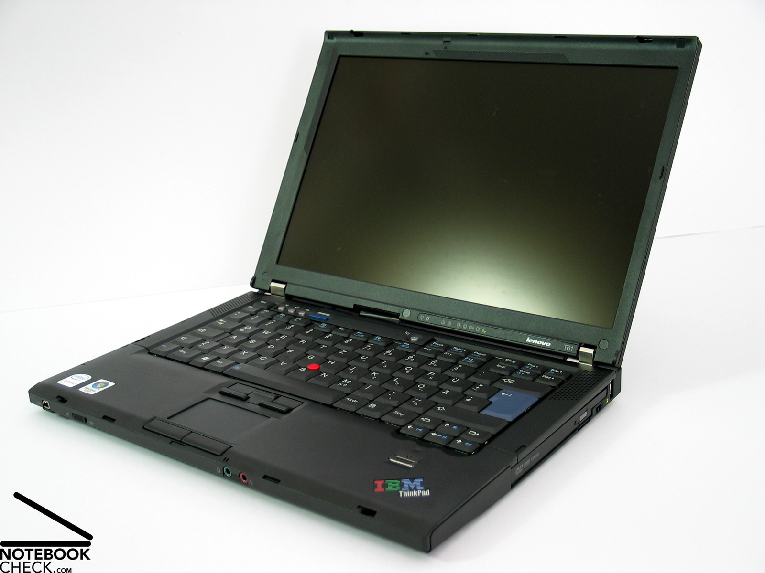
Information Technologies
Reliable, cost-effective and efficient business solutions for Orange County

Slide 11
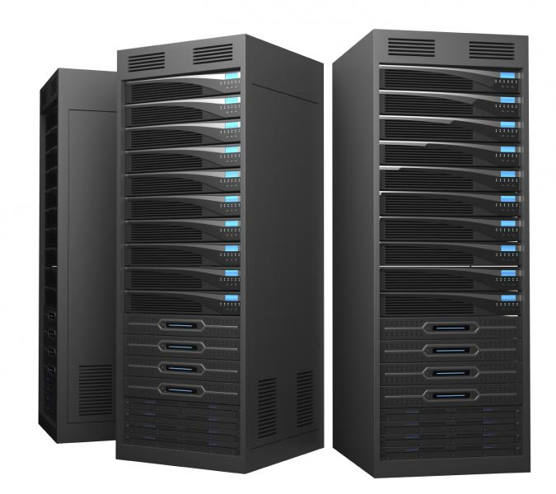
Ongoing Initiatives:
Energy efficient computer fleet
Mobile workforce
Virtualization
Storage Consolidation
Remote support

Slide 12
Future Initiatives
CHCCS Computer Reuse and Training Program
  Not just e-waste recycling
  Public – Private
  Tech Career Training Program
  Expandable

Slide 13
  Planning, Inspections, Engineering/Erosion Control, & Orange Public Transportation (OPT)
  Promoting stable and quality development while protecting the environment

Slide 14

Green Building Standards
Ongoing:
    Representation on Durham-Orange-Chatham Home Builders Association Board of Directors and NC Building Inspectors Association BoD
    Volunteer incorporation of practices
Planned/Proposed Initiatives:
Representation on NC Building Code Council
Waste Water Technologies That Lessen Environmental Impacts
Current Year Initiatives:
Research with Environmental Health on siting and alternatives to on-site septic systems
Planned/Proposed Initiatives:
BOCC consideration of siting/zoning alternatives and innovations to on-site septic systems

Slide 15

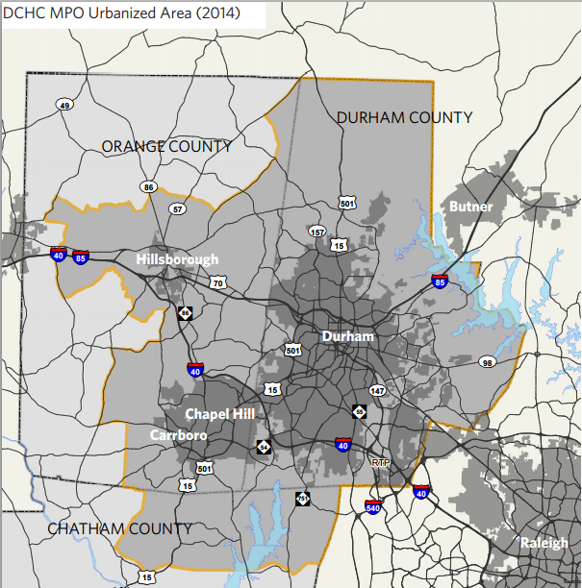
Local and Regional Air Quality:
Ongoing:
Seated staff on Durham-Chapel Hill-Carrboro Metropolitan Planning Organization (MPO) Technical Committee
Current Year Initiatives:
Collection of data for 2045 Metropolitan
Transportation Plan (MTP) and Air Quality
Analysis Report
Draft Mobility Report Card for MPO
Planned/Proposed Initiatives:
Propane conversion for OPT’s new buses
2045 MTP and Air Quality Analysis Report
Congestion Mitigation Air Quality (CMAQ) grant funding for OPT

Slide 16
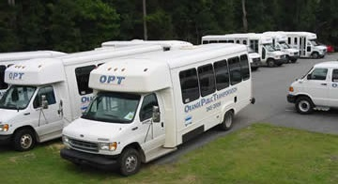
Promote Public Transportation/Decrease Dependence on Personal Vehicles
Ongoing:
OPT -- Outreach and education
Comprehensive Transportation Plans (CTPs)
Southern Human Services Center Special Use Permit compliance and Travel Demand Management
Current Year Initiatives:
Design of OPT’s expanded bus services
Pursuing funding opportunities for bus capital and operations
Efland-Hillsborough Commuter Loop tour and Earth Evening
Planned/Proposed Initiatives:
Expanded OPT services
Rebranding of OPT

Slide 17
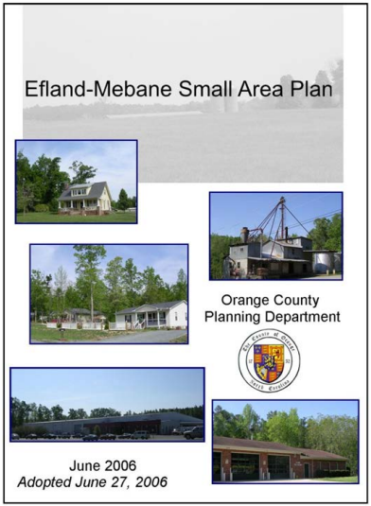
Increase Connectivity
Ongoing:
Subdivision administration
Access Management Plan implementation
Current Year Initiatives:
Adopted Efland zoning overlay districts including
connectivity standards
Consultant environmental analysis in Buckhorn area for
access management planning
Planned/Proposed Initiatives:
Efland/Buckhorn/Mebane Access Management Plan amendment
promotes funding and economic activity

Slide 18
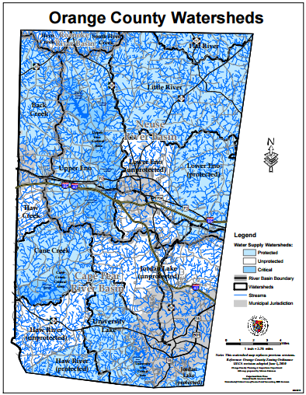
Protecting Groundwater
(Also Surface Water)
Ongoing:
    Unified Development Ordinance (UDO) -- Watershed regs
    Erosion Control and Stormwater Ordinances
    Surface Water Identification (SWID)
Current Year Initiatives:
Agricultural Support Enterprises included standards that
in some cases will require groundwater studies
Planned/Proposed Initiatives:
    UDO amendment to provide incentive for implementing infiltration type Best Management Practices (BMPs)
    Additional public education and outreach promoting infiltration type BMPs , Low Impact Development, and buffer preservation/environmental stewardship
    State changes (unfunded mandates) to Falls and Jordan Lake nutrient management programs are pending
    Maintain appropriate staffing levels for meeting the BOCC Environmental Responsibility Goal

Slide 19
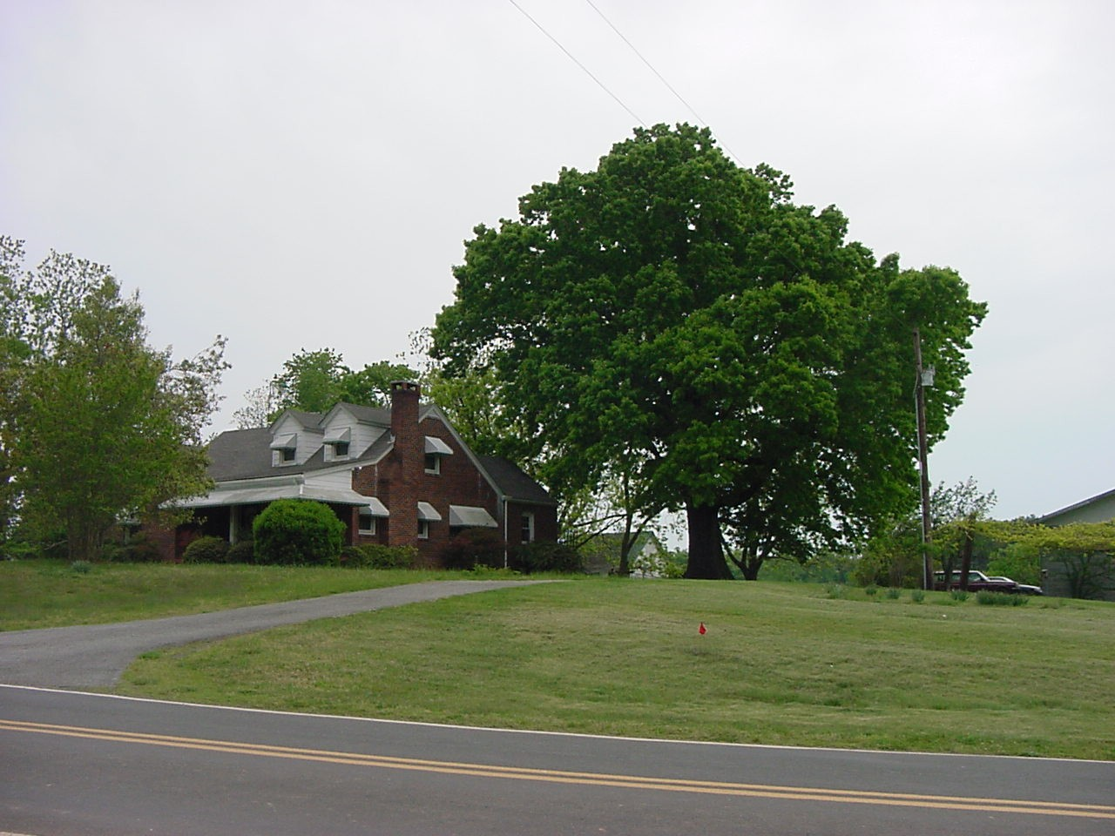
Directing Development to Appropriate Areas
Ongoing:
2030 Comprehensive Plan and UDO/zoning
Protection of open space within subdivisions
Water and Sewer Management Planning and Boundary Agreement
Current Year Initiatives:
Adopted Efland zoning overlay districts seek to direct development to an identified growth area served or to be served by public water/sewer systems
Planned/Proposed Initiatives:
Clustering of residential lots to preserve additional open space and protect significant environmental site attributes

Slide 20
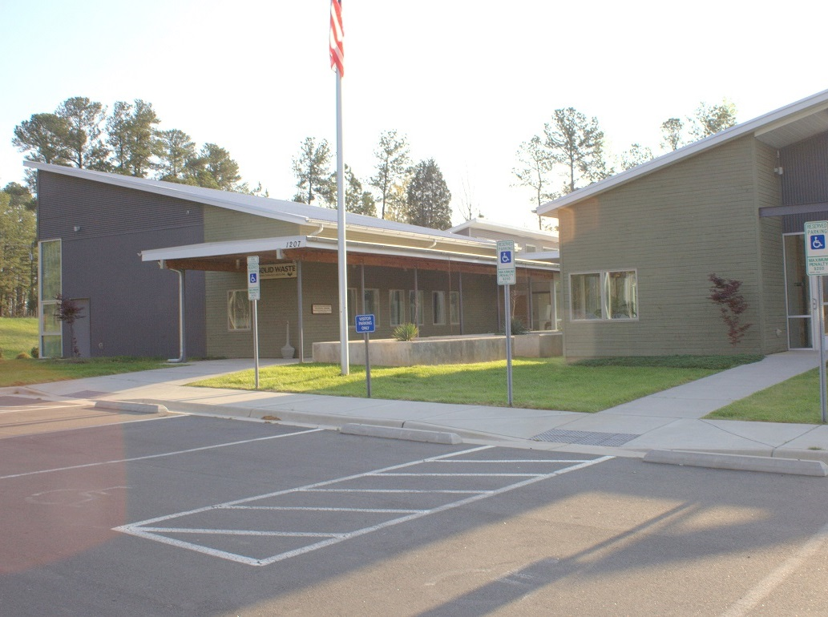
  Solid Waste Department

Slide 21
Solid Waste Goal and Results for FY 13-14
 | State of NC | Orange County
Reduction Goal | 40% | 61%
Reduction Achieved | 13% | 64%
Pounds landfilled per person | 1,860 | 980

Slide 22
Rural & Urban Curbside Recycling Performance:
Tonnage Comparison 2014 vs. 2015
URBAN | July 2013 – April 2014 | July 2014 – April 2015 | % Increase | Comments
Tons | 3,933 | 4,365 | 11% | 100% residences have carts by July 2014
RURAL | Feb 2014 - April 2014 | Feb 2015 – April 2015
Tons | 396 | 533 | 34% | 55% of currently eligible rural residences using carts by April 2015 (rest use bins or go to convenience sites or don’t recycle)

Slide 23
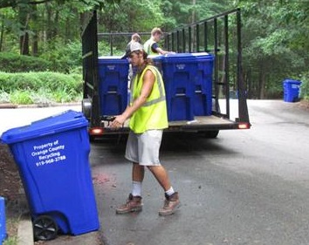
Solid Waste Current Initiatives
Cart- based recycling instituted for:
  ~ 100% of 18,300 urban residential customers by July 2014
  and
  7,800 of 14,500 eligible rural residential customers by April 2015 (300 more ordered to meet additional demand)
Complete Interlocal Agreement for Solid Waste Management with Towns, UNC and UNC Healthcare -- December 2015
Eubanks Road Solid Waste Convenience Center design completed; construction anticipated
beginning -- August 2015
Municipal solid waste to Durham
Transfer Station continues for 2015-16
Single, County-wide Solid Waste
Programs Fee adopted for FY 2015-16
(no more 3-R Fees or convenience center
fees)

Slide 24
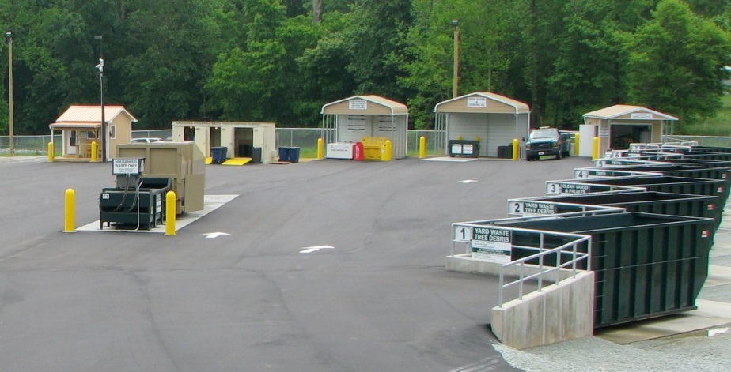
Solid Waste Future Initiatives
Three year phase-in of roadside recycling to remaining unserved ~7,000 rural single family households, in bins or carts as desired, Beginning FY 2015-16. Completion projected Spring 2018
Continue modernization of Solid Waste Convenience Centers
  High Rock site renovation projected per FY 16-17 C.I.P.
Continue considering alternatives to Durham City Transfer Station
Evaluate commercial recycling improvement options
Examine program consolidation and cooperation opportunities with UNC and UNC Health Care
Continue to explore long-term regional
solid waste collaborative opportunities
outside of Orange County

Slide 25

Orange County Leads the Way in Special Event Recycling
Hillsborough Hog Day
Most environmentally improved
From 0% to 85% waste reduction in 10 years
Farm-to-Fork and Terra Vita
99% waste diversion
Carrboro Music Festival
Recycles a ton of bar glass. Literally.
Over 300 volunteer hours.

Slide 26
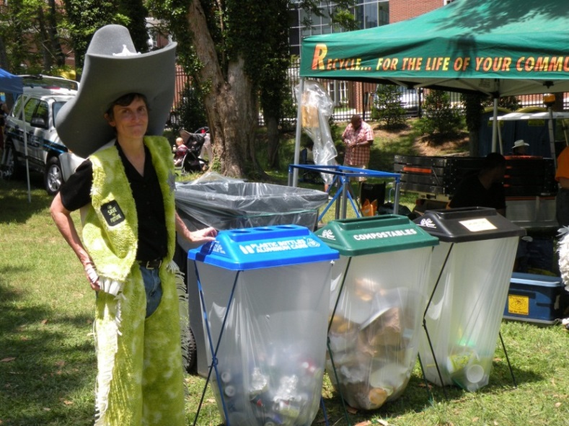
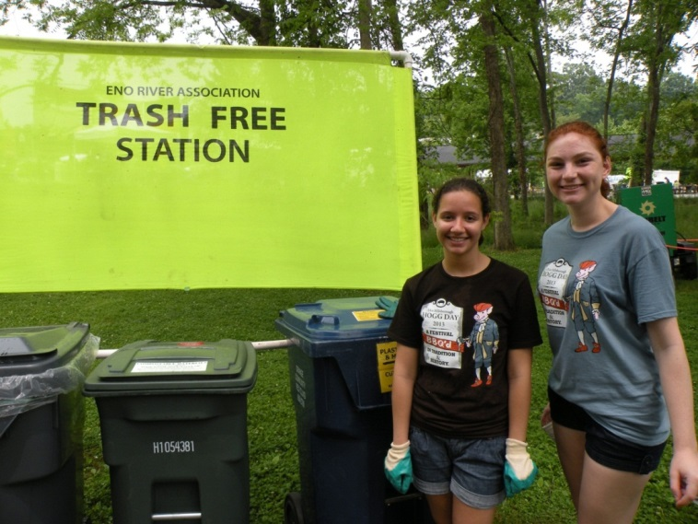
Many Benefits
GREAT education opportunities
  Local government collaboration
  Community outreach
  Food service industry involvement
  Student volunteers
Sponsor status for OC
Saves money on disposal
Reduces waste
Models “Going Green”

Slide 27
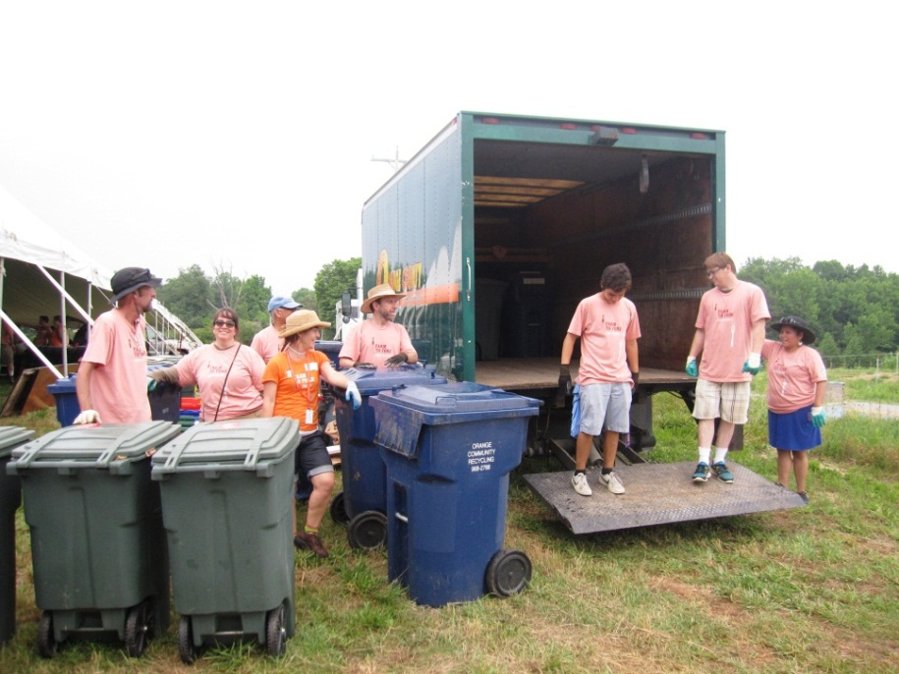
Orange County provides
waste reduction assistance to public & private events
Technical assistance for recycling, food waste diversion, and source reduction for vendors and organizers
Containers, collection, equipment and staffing for large events where we also host an information booth
Loan, delivery and pick-up of recycling and/or food waste containers for events where organizers agree to collect, manage and separate materials
Information booth and outreach at public events

Slide 28
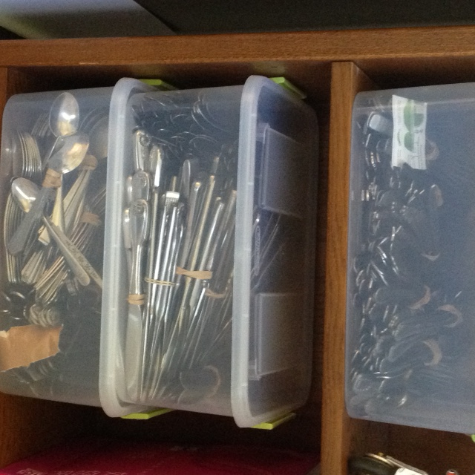
New This Spring!
“Fork It Over”
200 stainless steel utensil sets from PTA Thrift Store and other donors.
Loan, wash, return!

Slide 29
Now in development:
The Orange County Green Events Guide
Conduct focus groups to identify strengths, barriers and solutions:
  Invite representatives from each department
  Schedule several groups over the summer
Tools to help Orange County Government entities reduce waste at events where food is served.
  Waste reduction checklist
  Purchasing guide for recyclable and compostable serving ware
  Collections protocol

Slide 30
  Asset Management Services
  Providing and maintaining facilities and vehicles that are safe, reliable, sustainable, clean and comfortable

Slide 31

FY 14 Utility and Fuel Scorecard
  Reduction Goals
  (Baseline = FY10)
  Energy
    FY15 20%
    FY17 30%
  Water
    FY17 5%
  Fuel
    FY15 10%
    FY17 15%
Parameters held constant
  AMS facilities and vehicles only
Have not included:
  SportsPlex;
  Animal Services
  Solid Waste facilities or vehicles
  Eno River Parking deck
  Outdoor lighting
Future reports to include all buildings and vehicles

Slide 32
Energy
Scorecard
Energy Use (MMBTU/ 1,000 Sq. FT of Occupied Space)
 | Goals |  | Actuals
 | MMBTU/ 1,000 Sq. Ft. | % Change from Baseline | MMBTU/ 1,000 Sq. Ft. | % Change from Baseline
FY 10 | 96.2 |  | 96.2
FY 11 | 92.4 | 4% | 91.4 | 5.0%
FY 12 | 88.5 | 8% | 84.5 | 12.2%
FY 13 | 84.7 | 12% | 82.4 | 14.3%
FY 14 | 80.8 | 16% | 79.7 | 17%
FY 15 | 77.0 | 20%
FY 16 | 72.2 | 25%
FY 17 | 67.3 | 30%

Slide 33
Water Scorecard
Water Consumption (Total Gallons)
 | Goals |  | Actuals
 | Gallons/ Sq. FT. | % Change From Baseline | Gallons/ Sq. FT. | % Change From Baseline
FY 10 | 15.93 |  | 15.93
FY 11 | 15.82 | 0.7% | 13.03 | 18.2%
FY 12 | 15.71 | 1.4% | 15.19 | 4.6%
FY 13 | 15.59 | 2.1% | 14.87 | 6.7%
FY 14 | 15.48 | 2.9% | 15.07 | 5%
FY 15 | 15.36 | 3.8%
FY 16 | 15.25 | 4.3%
FY 17 | 15.13 | 5.0%

Slide 34
Fuel Scorecard
 | Fuel Consumption (Total Gallons) |  |  |  | Fuel Efficiency (MPG)
 | Goals |  | Actuals |  | Goals |  | Actuals
 | Gallons | % Change From Baseline | Gallons | % Change From Baseline | MPG | % Change From Baseline | MPG | % Change From Baseline
FY 10 | 240,813 |  | 240,813 |  | 12.82 |  | 12.82
FY 11 | 235,997 | 2% | 251,382 | -4.4% | 13.07 | 2% | 12.83 | 0.1%
FY 12 | 231,180 | 4% | 252,708 | -4.9% | 13.33 | 4% | 12.16 | -5.1%
FY 13 | 226,364 | 6% | 260,039 | -8.0% | 13.59 | 6% | 11.78 | -8.1%
FY 14 | 221,548 | 8% | 259,321 | -8.0% | 13.84 | 8% | 11.70 | -9.0%
FY 15 | 216,732 | 10% |  |  | 14.10 | 10%
FY 16 | 210,711 | 12% |  |  | 14.42 | 12%
FY 17 | 204,691 | 15% |  |  | 14.74 | 15%

Slide 35
Miles Per Gallon

Slide 36
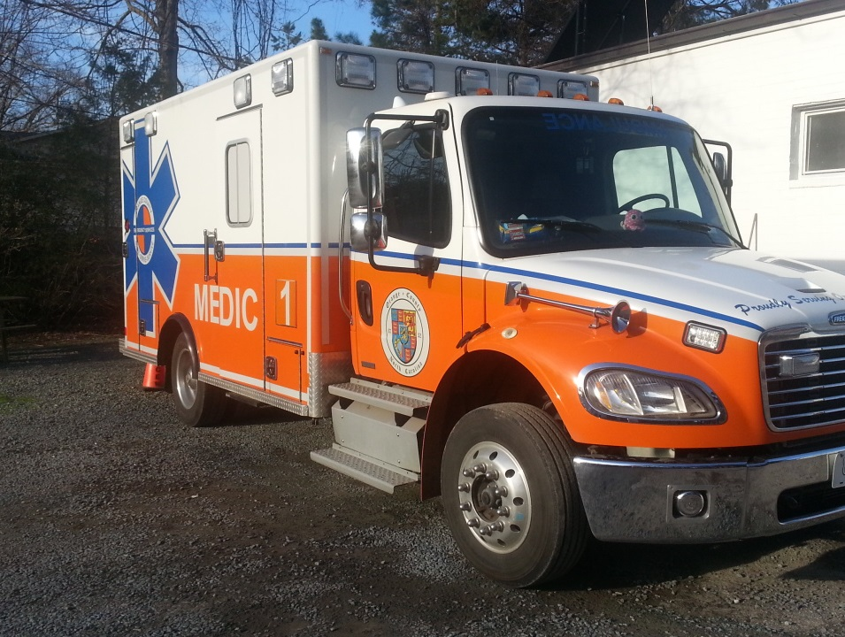
Fuel Scorecard Comments
+16%
Increased fuel use attributed to:
  Increased emergency response vehicle miles
  Driver behavior including idling, hard acceleration, hard braking, speeding
Solution:
  Ambulance idle reduction pilot
  Propane fire inspection vehicles
  Active vehicle replacement program;
  Higher fuel efficiency standards;
  Driver behavior training and education
+3%

Slide 37
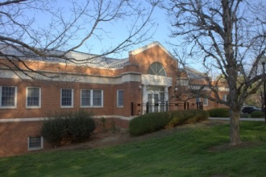
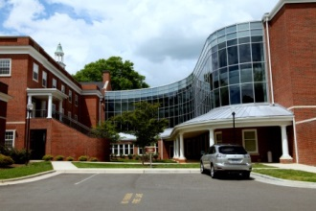
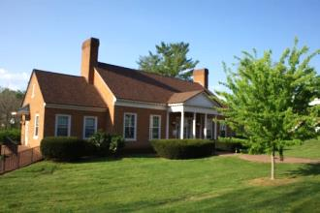
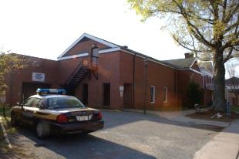
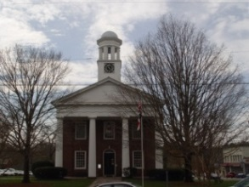
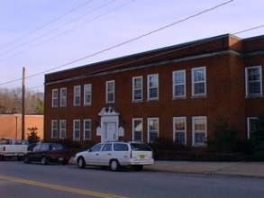
Current year initiatives
Geothermal Project
All Buildings
Energy Saved To Date (MMBTUs) | Cost Avoided To Date
11,000 | $ 185,000

Slide 38
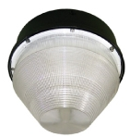
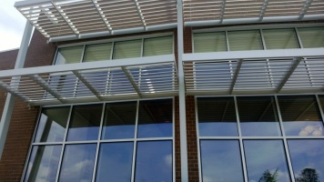
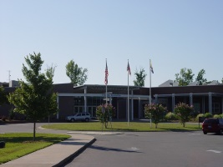

Investments and Priorities
Total Initial funds: | $100,000
Invested Funds To Date: | $41,220
FY16 Proposed Projects: | $47,700
Estimated Project Savings To Date: | $17,000
Current
  Energy Bank
Future
  Energy Bank project contest
  Studying decentralizing utility payments
  Underserved community target area analysis
5.6 years
9 years
<1 year
<1 year

Slide 39
Other Initiatives
Current
  Space study
  Sustainable commute survey
  Green and reflective roofing
  Solar power pilot project
  EV charging stations
  Ambulance idle reduction
Future
  HVAC controls optimization
  Telework policy
  Energy storage assessment
  Event waste reduction guide
  Computer reuse partnership
  GPS vehicle efficiency monitoring
  Propane vehicle conversions
  Vehicle pooling

Slide 40
Other Initiatives
Current
  Space study
  Sustainable commute survey
  Green and reflective roofing
  Solar power pilot project
  EV charging stations
  Ambulance idle reduction
Future
  HVAC controls optimization
  Telework policy
  Energy storage assessment
  Event waste reduction guide
  Computer reuse partnership
  GPS vehicle efficiency monitoring
  Propane vehicle conversions
  Vehicle pooling
78% interested in telework
Telework committee formed
Summary on AMS website

Slide 41
Thank you
Questions?

