Slide 1
OCHA Board Meeting
February 17, 2022

Slide 2
Plenty of discussion time available in tonight’s meeting
Minutes & Member Updates
Program Manager Report
Annual Report & Work Plan
Program Goals
Housing groups

Slide 3
Opening meeting items
Minutes from January 20th
Motion to approve
Member updates

Slide 4
Program Manager Report

Slide 5
VMS report numbers unchanged from last month
Staff will submit January Voucher Management System (VMS) report next week
Will report January VMS at March meeting
Will report February & March VMS at April meeting

Slide 6
Seeing a slight rise in lease-up times, which continue to be high
Since October 2020, OCHA has issued 174 vouchers
Of those, 109 are leased up
Average lease-up time: 106 days (up from 97)
Median lease-up time: 86 days (up form 79)
Staff coordinating with Housing Access Coordinator and OC Partnership to End Homelessness staff
Locating people
Tiered housing search supports that ramp up when it’s taking voucher holders a longer time to find a unit
In the past, have terminated vouchers for people unable to find units
Now applying trauma-informed lens to allow longer lease-up times

Slide 7
Several exciting updates to report
Lindy Grainger will be joining our team as Housing Choice Voucher Specialist next week
Staff continuing talks with agencies about Project Based Vouchers (PBVs)
Community Home Trust – Jay Street Development
CASA – Homestead Gardens

Slide 8
More forward momentum on longstanding items
Homeownership (HOV): manager will be updating materials for release next month
Database conversion making progress
Change from Elite to Yardi systems
Yardi contract ready to route
Staff considering consulting services to assist with data conversion

Slide 9
And progress continues on special programs as well
Nine Emergency Housing Vouchers (EHV) issued, one leased up
Five Foster Youth Initiative (FYI) applications sent to program partner OC Dept. of Social Services
Staff working with HUD and County Finance Dept. on detailed finance issues
Restricted Net Position (RNP) – the amount of funding received less amount disbursed

Slide 10
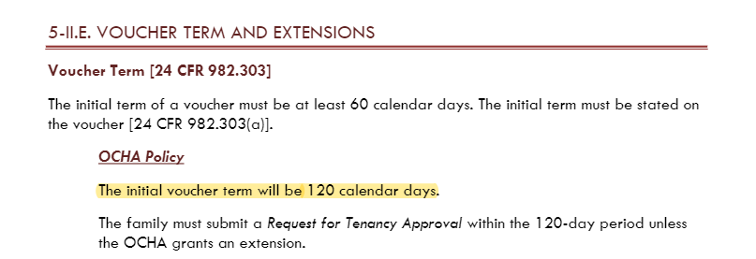
Staff request review of voucher and extension terms in Admin Plan
Voucher term: Pg. 13 of 15
Page numbers being addressed in Admin Plan revision

Slide 11
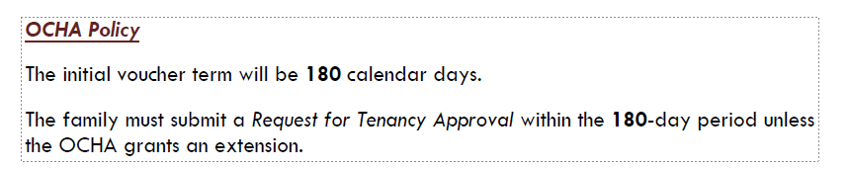
Staff recommend the following change
Initial term: “The initial voucher term will be 120 calendar days”
Change “120” to “180”

Slide 12
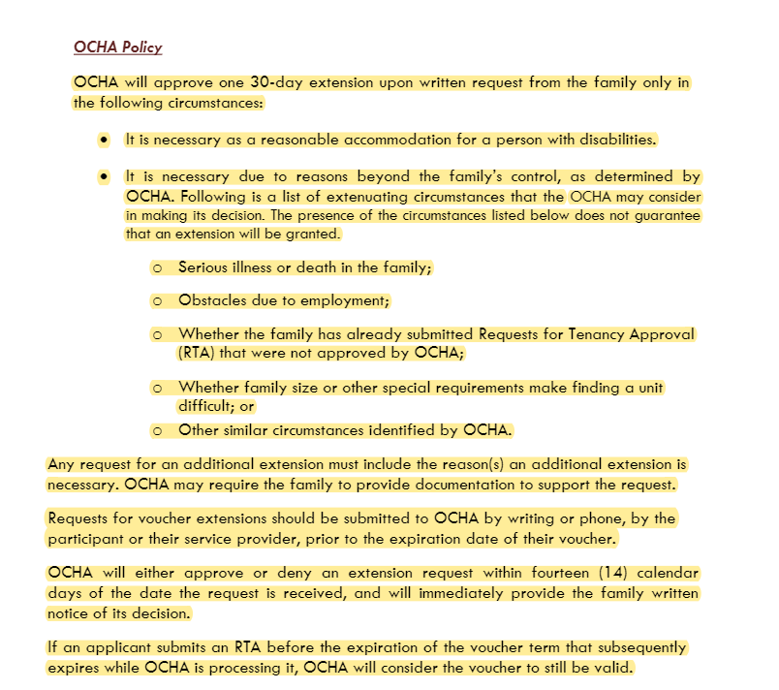
Staff request review of voucher and extension terms in Admin Plan
Extension term: Pg. 14 of 15

Slide 14
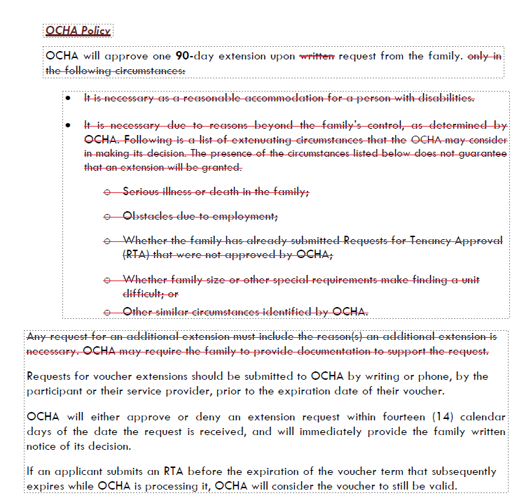

Slide 15
Potential policy change: staff recommend extending voucher and extension terms
Extensions: “OCHA will approve one 30-day extension upon written request from the family only in the following circumstances:”
Change “30” to “90” and eliminate circumstances required
Potential motion on these two changes

Slide 16
One admin plan item, continuing discussion from December meeting
Income limit chronic homelessness
A person referred via HOME Committee earns over 50% Area Median Income (AMI)
Also meets definition of chronic homeless
2+ years experiencing homelessness
Has a disability
Pros: trauma-informed, helping provide stability
Cons: not intended income bracket for voucher
Potential motion

Slide 17
As discussed, staff starting a comprehensive overview of the OCHA Admin Plan
This is the plan that lays out OCHA policies and procedures
Goals are increasing trauma-informed approach, increasing clarity, decreasing overall document size
Staff emailed before/after versions on Monday
Next steps?
Feedback?
Vote section by section or all at once?
Need more time for review?

Slide 18
Program Goals

Slide 19
Housing Department establishing 3-5 strategic goals for each section for 2022
Will use data dashboard at staff meetings
Housing Choice Voucher section goals
Lease ups within 90 days
Housing Assistance Payments (HAP) at 95%
90% of recertifications completed 60 days prior to anniversary
Distribute 2 newsletters to voucher recipients & landlords

Slide 20
Housing Groups & Housing Plans in Orange County

Slide 21
No shortage of plans and ideas
HUD Consolidated Plan
2030 Comprehensive Plan
Master Aging Plan
Chapel Hill Housing Plan
Chapel Hill Affordable Rental Strategy
Carrboro Affordable Housing Goals & Strategies
Plan to End Homelessness
Big Bold Ideas
COVID Recovery Plan – Housing Recovery Support Function

Slide 22
No shortage of groups working on affordable housing
Group | Members | Goals
OC Affordable Housing Coalition | Developers, Advocates, Staff | Fostering collaboration to promote increased affordable housing options in OC
OC Affordable Housing Advisory Committee | Appointed by Board of County Commissioners | Established 2001 to advise Commissioners on affordable housing

Slide 23
No shortage of groups working on affordable housing
Group | Members | Goals
Carrboro Affordable Housing Advisory Commission | Appointed by Carrboro Town Council | Established 2018 to advise Carrboro Councilmembers on affordable housing
Chapel Hill Housing Advisory Board | Appointed by Chapel Hill Town Council | Assist Town Council in promoting and developing full spectrum of housing opportunities

Slide 24
No shortage of groups working on affordable housing
Group | Members | Goals
Local Government Affordable Housing Collaborative | Elected Officials and staff from Towns and County | Serve as HOME consortium
OC Housing Authority Board | Appointed by Board of County Commissioners | Govern administration of OC Housing Authority (vouchers)

Slide 25
No shortage of groups working on affordable housing
Group | Members | Goals
Chapel Hill Town Council | Elected by Chapel Hill voters | Govern administration of Chapel Hill Housing Authority (site-based units)
Master Aging Plan Housing Subcommittee | Community stakeholders | Plan for and discuss housing issues related to seniors

Slide 26
Wrap Up

Slide 27
See you next month!
Next OCHA Board meeting will be March 17, 2022

Slide 28
Questions
Blake Rosser, HCV Program Manager
brosser@orangecountync.gov
919-314-7584
Corey Root, Housing Director
croot@orangecountync.gov
(919) 245-2492

