Slide 1
INTRODUCTION OF THE CAPITAL INVESTMENT PLAN FY2022-32 Board of Orange County Commissioners April 5, 2022
1

Slide 2
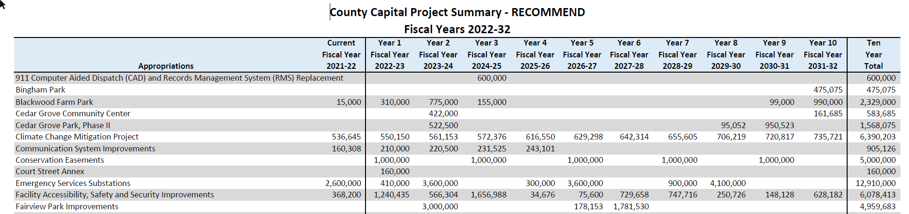
FY2022-32 Recommended Capital Investment Plan
Highlights and Changes
10 Year Project Enumeration
2

Slide 3
FY2022-32 Recommended Capital Investment Plan
Highlights and Changes
10 Year Debt Modeling
Additional School Funding Dashboard
Additional School Funding
Fiscal Year - Purpose |  | Amount
2024 - Additional Deferred Maintenance |  | 30,000,000
2027 - Hypothetical GO Tranche 1 |  | 45,000,000
2029 - Hypothetical GO Tranche 2 |  | 45,000,000
2031 - Hypothetical GO Tranche 3 |  | 40,000,000
Grand Total |  | $ 160,000,000
3

Slide 4
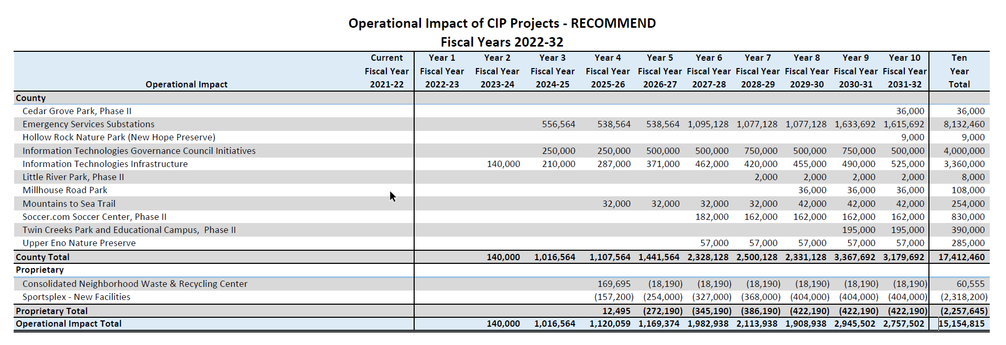
FY2022-32 Recommended Capital Investment Plan
Highlights and Changes
Renewed Focus on Impact to Operating Budget
4

Slide 5
FY2022-32 Recommended Capital Investment Plan
Major Education Projects
Supplemental Deferred Maintenance
Round 1 – FY 2020-21
$30 million over three (3) years ~ Now four (4) Years
Allocated by Average Daily Membership in FY2020-21 (CHCCS 59.99%; OCS 40.01%)
Round 2 – FY 2022-23
$3 million planning funds in FY 2022-23 and $27 million construction in FY 2023-24
Allocated by Average Daily Membership in FY 2022-23 (TBD)
Fiscal Year | Original Allocation | Recommended Allocation | Total by Year
FY2020-21 | $5,950,000 |  | $5,950,000
FY2021-22 | $3,600,000 |  | $3,600,000
FY2022-23 | $14,253,000 | $3,000,000 | $17,253,000
FY2023-24 | $6,197,000 | $27,000,000 | $33,197,000
TOTAL | $30,000,000 | $30,000,000 | $60,000,000
5

Slide 6
FY2022-32 Recommended Capital Investment Plan
Major Education Projects
Orange County Campus – DTCC - $500,000
Existing Building Expansion vs. New Stand Alone Facility
13,000 to 18,000 Square Foot Addition
Program Areas Served
Emergency Medical Services
Health and Wellness
Skilled Trades
Back to Work and Small Business Center
Student Study Areas
Student Support Services Office Space
Construction budgeted in FY2023-24 for $10.5 million
6

Slide 7
FY2021-26 Recommended Capital Investment Plan
Major County Projects
EMS Substation Plan
Precise Locations Guided by EMS System Analysis
Years 1 and 2 Colocation with Chapel Hill Fire - $300,000 for Planning in FY2022-23
Two Net New Substations in Years 5 and 8
Emergency Responder Radio System
New Approach Using Bi-Directional Antennas to Achieve Building Penetration
Reduce Number of Towers Needed
Study and Acquisition Funds in FY2022-23 - $347,500
Blackwood Farm Park Phase II Planning
New Hope Church Road Overlook
Picnic Area
Planning Funds in FY2022-23 - $110,000
7

Slide 8
FY2022-32 Recommended Capital Investment Plan
Capital Investment Plan by the Numbers
Total Recommended Capital Expenditures - $40.6 million
County Capital - $10.8 million
Proprietary Funds - $1.2 million
School Capital - $28.5 million
Decrease from FY2021-22 - $10.3 million
203 South Greensboro Project in FY 2021-22
Last General Obligation School Bond Draw in FY 2021-22
CHCCS - $1.9 million
OCS - $11.3 million
Debt Service - Decrease of $1,874,411
FY 2021-22 debt service offset by one-time revenues.
8

Slide 9
FY2022-32 Recommended Capital Investment Plan
9

Slide 10
FY2022-32 Recommended Capital Investment Plan
10

Slide 11
FY2022-32 Recommended Capital Investment Plan
11

Slide 12
FY2022-32 Recommended Capital Investment Plan
12

Slide 13
FY2022-32 Recommended Capital Investment Plan
13

Slide 14
FY2022-32 Recommended Capital Investment Plan
Tax Equivalent Analysis
Fiscal Year | FY2022-32 Recommended CIP | Need
FY2022-23 | .25 cents | To Fund Currently Approved Debt Projects
FY2023-24 | 1 cents | To Fund Supplemental School Deferred Maintenance
FY2024-25 | 0 cents
FY2025-26 | 0 cents
FY2026-27 | 1.12 cents | To Fund $130 M Bond Referendum
FY 2027-28 through FY 2031-32 | 0 cents
TOTAL | 2.37 cents
14

Slide 15
FY2022-32 Recommended Capital Investment Plan
Horizon Issues
Full Costs Not Included in FY2022-32 CIP
Full Funding of School Capital Needs
Crisis Diversion Facility
Affordable Housing
Community Center Space Needs
Central Recreation Center
Emergency Responder Radio System Build Out
County Master Facility Plan Recommendations
15

Slide 16
FY2022-32 Recommended Capital Investment Plan
Schedule for Consideration
Introduction of the Capital Investment Plan – April 5
Work Session on Capital Investment Plan – April 12
Further Consideration through Budget Work Sessions
Approval of the Operating and Capital Budget – June 21
16

